Slide 1
My Essential Values
Johnny Stack

Slide 2
Values
Altruism
Patience
Conviction
Enthusiasm
Gratitude

Slide 3
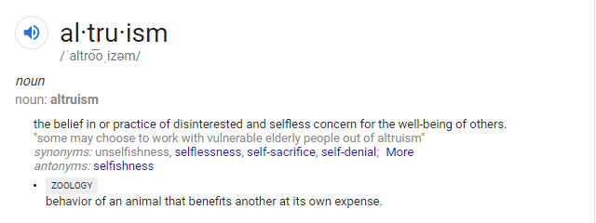
Altruism - Definition
To me, altruism means being selfless or giving to other people, even when there may be nothing to gain and something to lose. Altruistic people do things for the collective interest instead of their own.

Slide 4
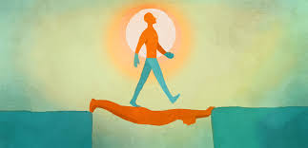
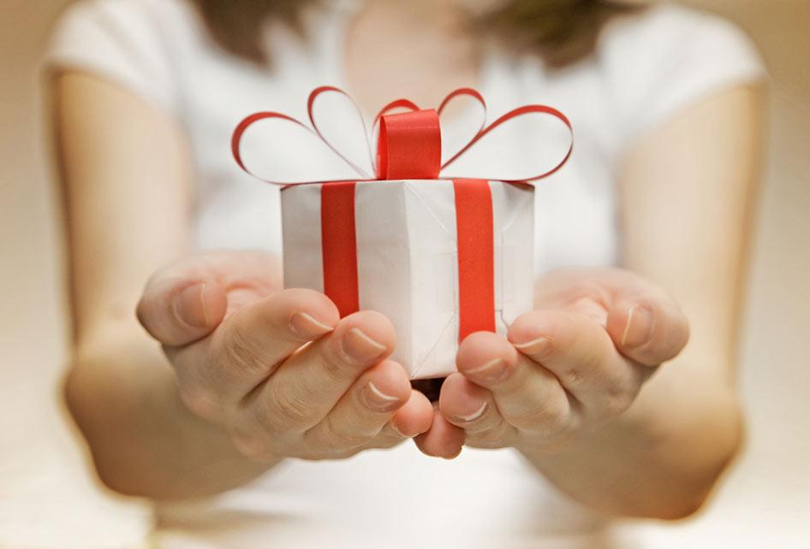
Altruism - Practice
Why practice altruism? Practicing altruism is important because it helps benefit the whole of society and mankind. Also, being giving to other people will also help yourself in the end because altruism promotes a brighter future for everyone. Helping other people helps yourself, and it just feels good. As the saying goes, what goes around, comes around. Some argue that altruism is naturally encoded in our genetics because it helps keeps our species alive when we cooperate. There are many ways that we can practice altruism, and though it should maybe be practiced more, it occurs all the time. From volunteering at your local homeless shelter or soup kitchen to even simple things like giving presents to the people close to you, putting a smile on someone else’s face and giving back means the world, regardless of how big the selfless act is. For example, I practice this day to day in often not too impactful of ways, such as letting someone go ahead of me in traffic, giving money to homeless people and people who I see are desperate, giving my spot to someone on the lightrail if it’s pretty packed and they could use the seat more.

Slide 5
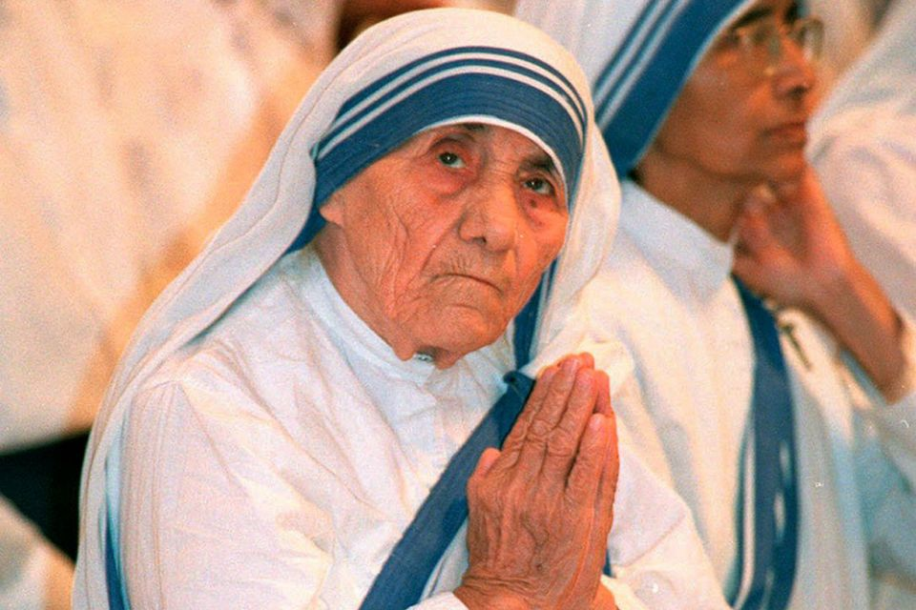
Altruism - Role Model
Mother Teresa is an inspirational role model to many people, but specifically to me, her life has inspired me to be less selfish and more humble. She was a Roman Catholic nun and missionary and her life’s work, which was to dedicate herself to the assistance of the impoverished and desperate, I believe is the epitome of altruism. Throughout her life, she was devoted to spending time with the poor because she believed in love in action, and that Jesus Christ’ light and love shines through all of us. After she moved to India when she was 18 with a group of nuns, she spread a contagion of this love in action throughout the entire Indian community, step by step, until even Indian government officials recognized her selfless acts. She received a nobel peace prize in 1979.

Slide 6
Patience - Definition
In my own words, I would say patience means being able to wait, even through stressful and infuriating situations, often in order to achieve a better result.

Slide 7
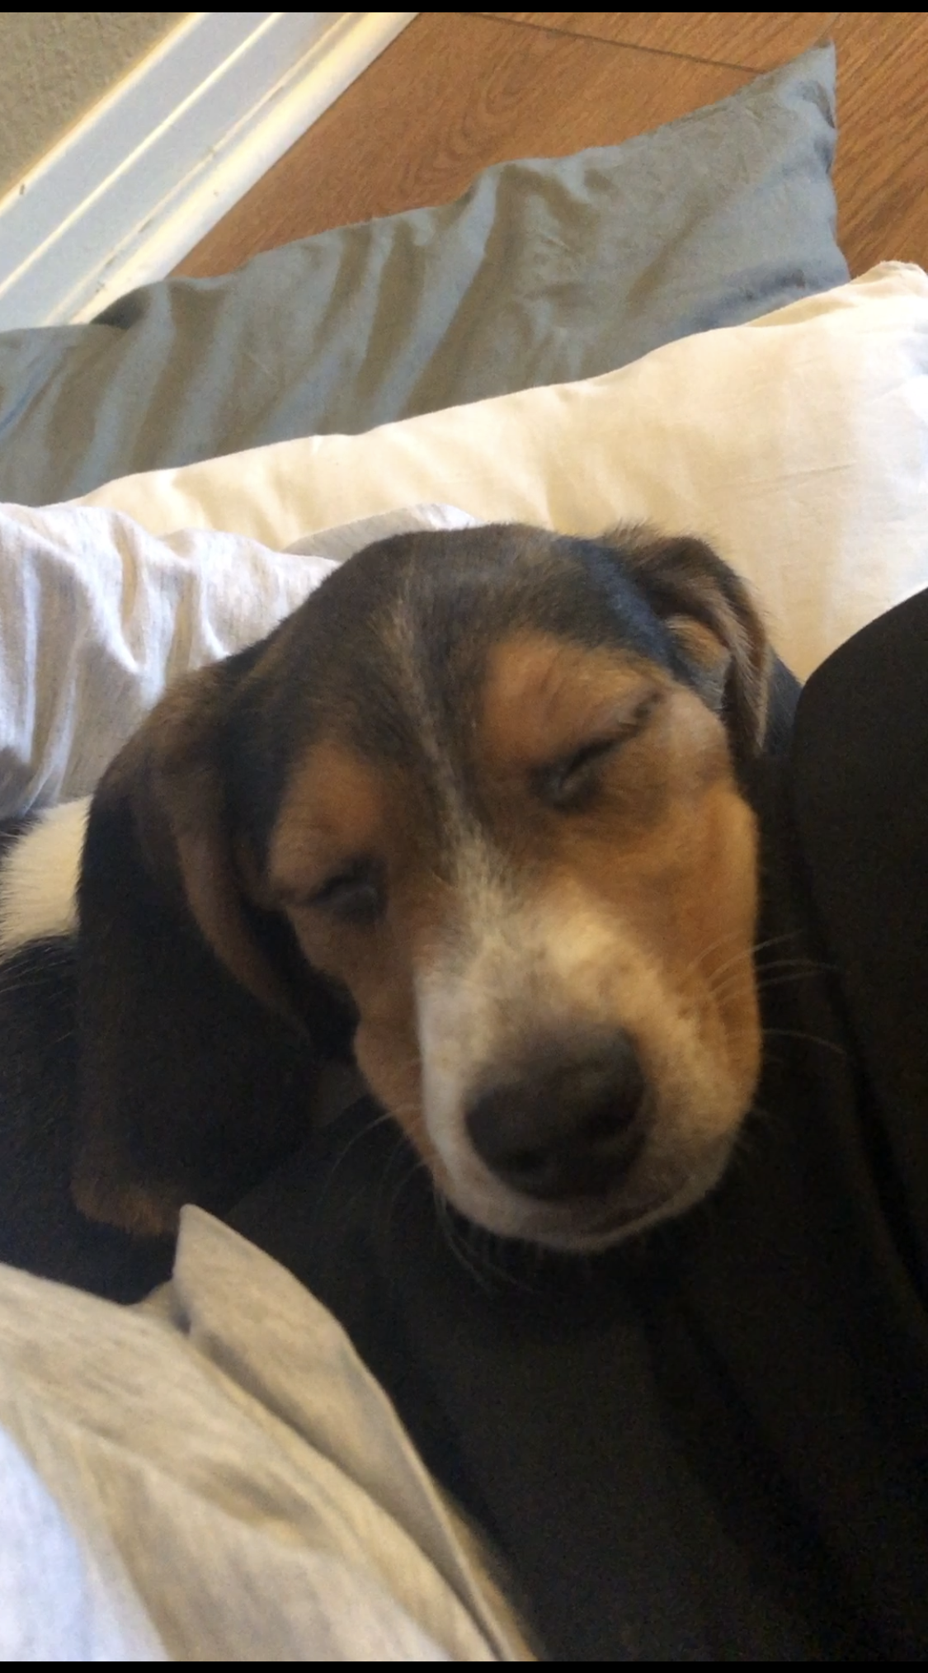
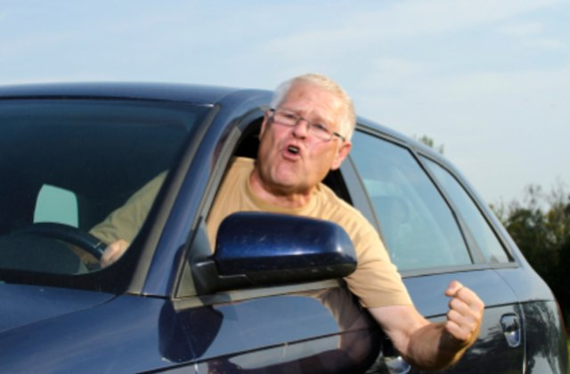
Patience - Practice
Patience is a very important virtue to practice because if you expect immediate gratification from most things, often times you will leave disappointed. Many good things take time to blossom to reach their full potential and there is no use in getting frustrated. While facing difficult or challenging situations, it’s always best to just take a few deep breaths and destress yourself so that you can proceed with the clearest mind to make the best decision. Other coping exercises such as taking a break from what’s causing you stress or doing something you love can help de-escalate your emotions in intense scenarios. I practice patience every day by doing a myriad of things, such as when the person in front of me on the highway is going ten under, or when there’s a line at the grocery store, or when my mother has stretched out a phone call to 25 minutes.

Slide 8
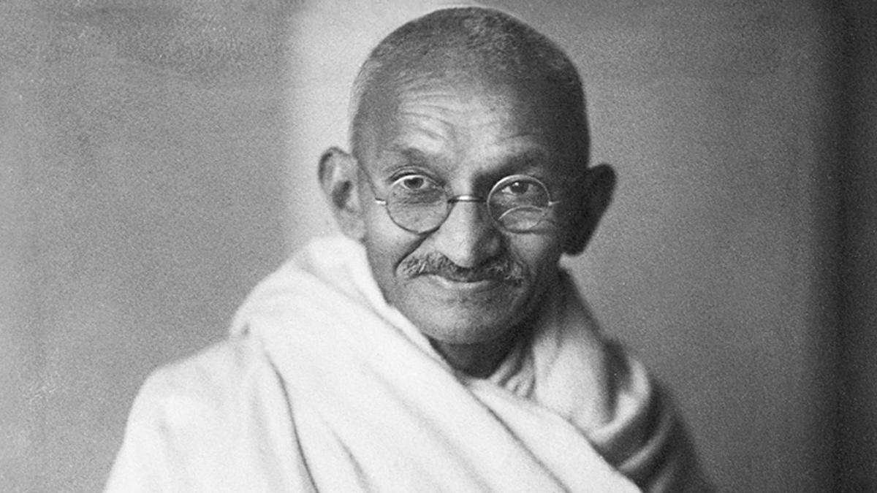
Patience - Role Model
.
Truly, there are not many more patient than Mahatma Gandhi, who is most known for his nonviolent political resistance and protests regarding India’s freedom from Great Britain. In 1896, he wrote an article called “The Green Pamphlet” which described the discrimination that Indians faced in South Africa. Over the next couple of years, Gandhi and the British government clashed constantly, and they viewed him as a troublemaker and anti-government. In fact, he was anti-colonialism, and made this stance perfectly clear when events from the past decades culminated into the Transvaal Asiatic Registration Act, where the British government in India required all Indians to register and give identification immediately. He vehemently protested this and encouraged others around him to resist, setting off seven years of protests, many of which revolved around fasting, refusing food for days at a time, as a form of political protest.

Slide 9
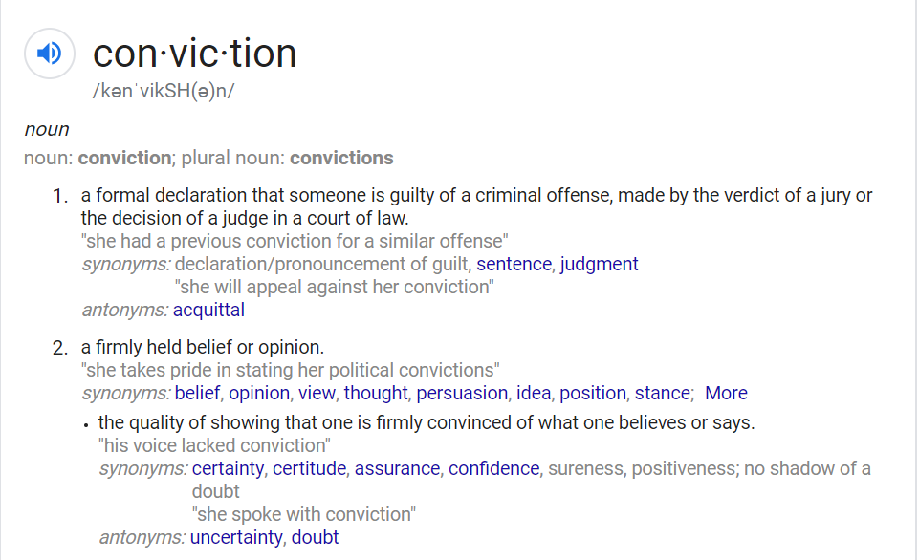
Conviction - Definition
In other words, I think conviction means showing confidence in what you believe in and know is the truth, and to stand by it.

Slide 10
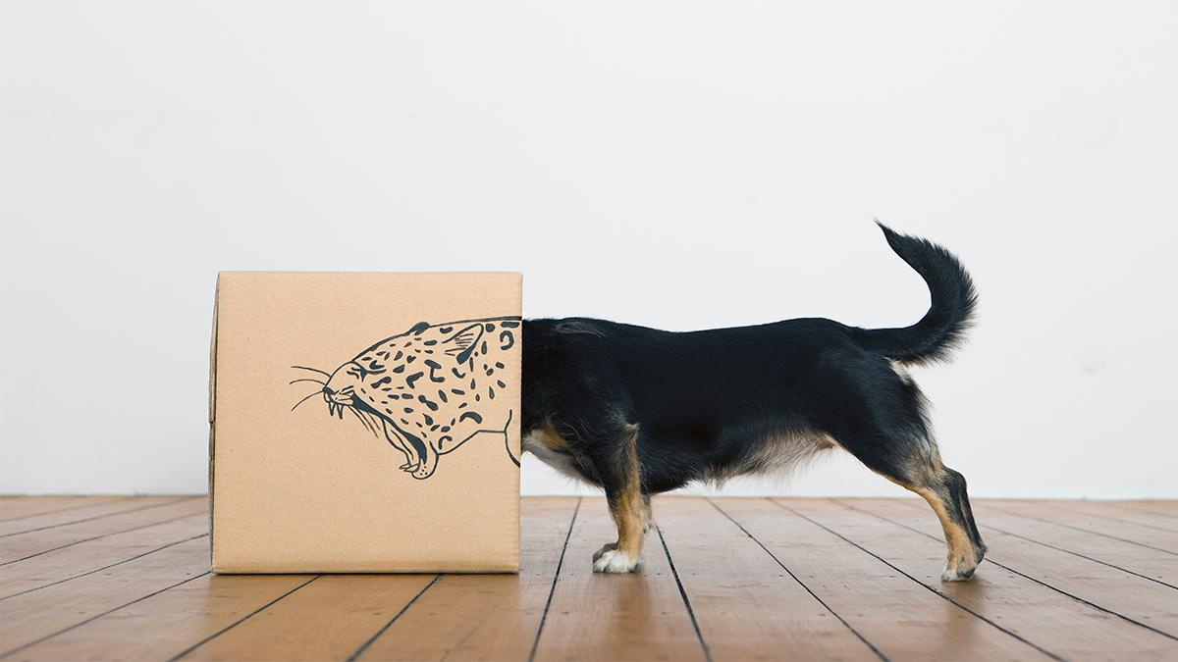
Conviction - Practice
Conviction should be practiced because if you aren’t going to hold your ground resiliently and believe in yourself and what you stand for, then no one will. Many great and powerful leaders are only where they are today because they have conviction. We can practice conviction by being knowledgeable about what we’re talking about so that we have the utmost confidence in ourselves. In my personal life, conviction is practiced by me not allowing myself to be pushed around or tread on, and by being confident in the decisions I make.

Slide 11
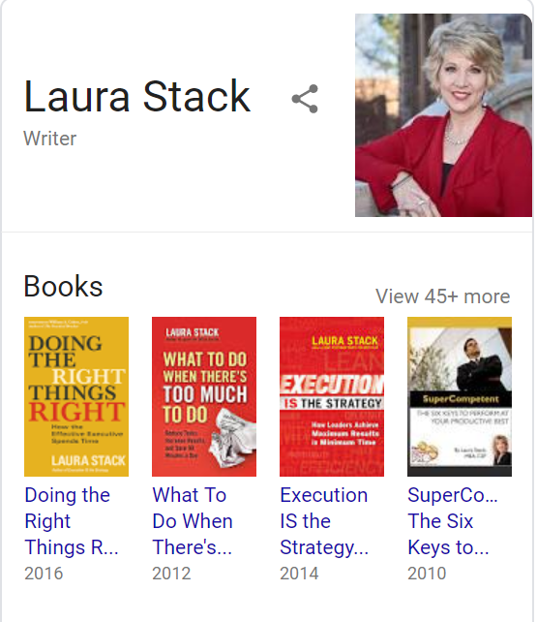
Conviction - Role Model
Though it may appear to be cliche and overdone, the biggest role model in my own life is my mother, Laura Stack. She is one of the most dedicated people I know to her profession, which is being an author and a speaker. She travels all across the world, speaking about time productivity and using her books as references. She truly is the definition of a competent, assured professional and she always believes in what she’s doing. Her leadership skills that she’s developed throughout her life have lead her to where she is today and creating her own independently run business, The Productivity Pro, and being a symbol of conviction to me and many others.

Slide 12
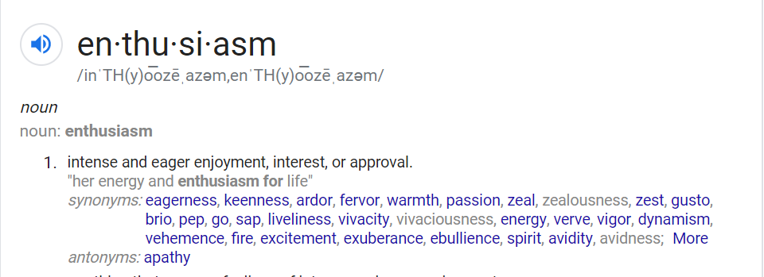
Enthusiasm - Definition
To summarize, enthusiasm is approaching every obstacle or situation with the utmost of optimism and cheerfulness.

Slide 13
Enthusiasm - Practice
Enthusiasm is essential to practice because if you enter into a situation where you’re thinking negatively, the outcome will also most likely be negative. We literally are our headspaces, and emit different energies based on our moods and perspectives. These energies are contagious, and how you behave could potentially impact someone else around you. If you go into an event optimistically and thinking positively, regardless if you logically think the opposite. You’re more likely to accomplish what you desire and succeed more when you are in control of your own attitude. We can practice this by finding the good things in even dire circumstances, because there is always a silver lining to every misfortune. This is practiced every day personally by reminding myself that sometimes wonderful things can come out of meager situations, doing my best to have a smile on my face, and thinking positively even when it’s not the easiest thing to do.

Slide 14
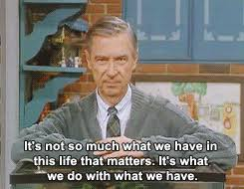
Enthusiasm - Role Model
Fred Rogers was an angel of a human being, and we never deserved him. He created and starred in a show called Mister’ Rogers Neighborhood, which was chock full of life lessons. I watched this show growing up, and I believe it was essential for my development and taught myself and other children to have a positive outlook on life.

Slide 15
Gratitude - Definition
Simply put, expressing gratitude is showing you’re thankful for what you have, or a kind act.

Slide 16
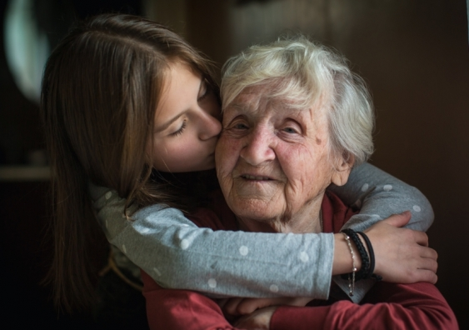
Gratitude - Practice
Most people practice gratitude at one point or another, but I believe it’s crucial because so often, we take what we have for granted. For example, there is no other you in this entire universe. The chances of you being born are 1 in (lets just say, a lot), and that is incredible in itself, and worthy of appreciation by every single person. If you’re able to appreciate what you have you’re also able to succumb to the dreading realization that there are MANY people out there who have it a lot worse than you do. We can practice this by knowing that even though you may not be the most privileged person in certain regards, we should be thankful for every little thing that we do have. I practice this by always showing my appreciation to those who support me, including my friends, family, and coworkers, and by being thankful that I have all the basic necessities - a roof over my head, food, water, a bed, and much more.

Slide 17
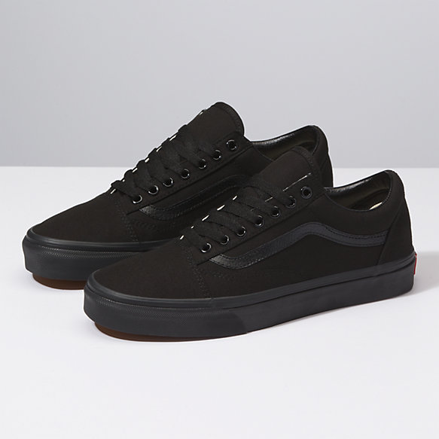
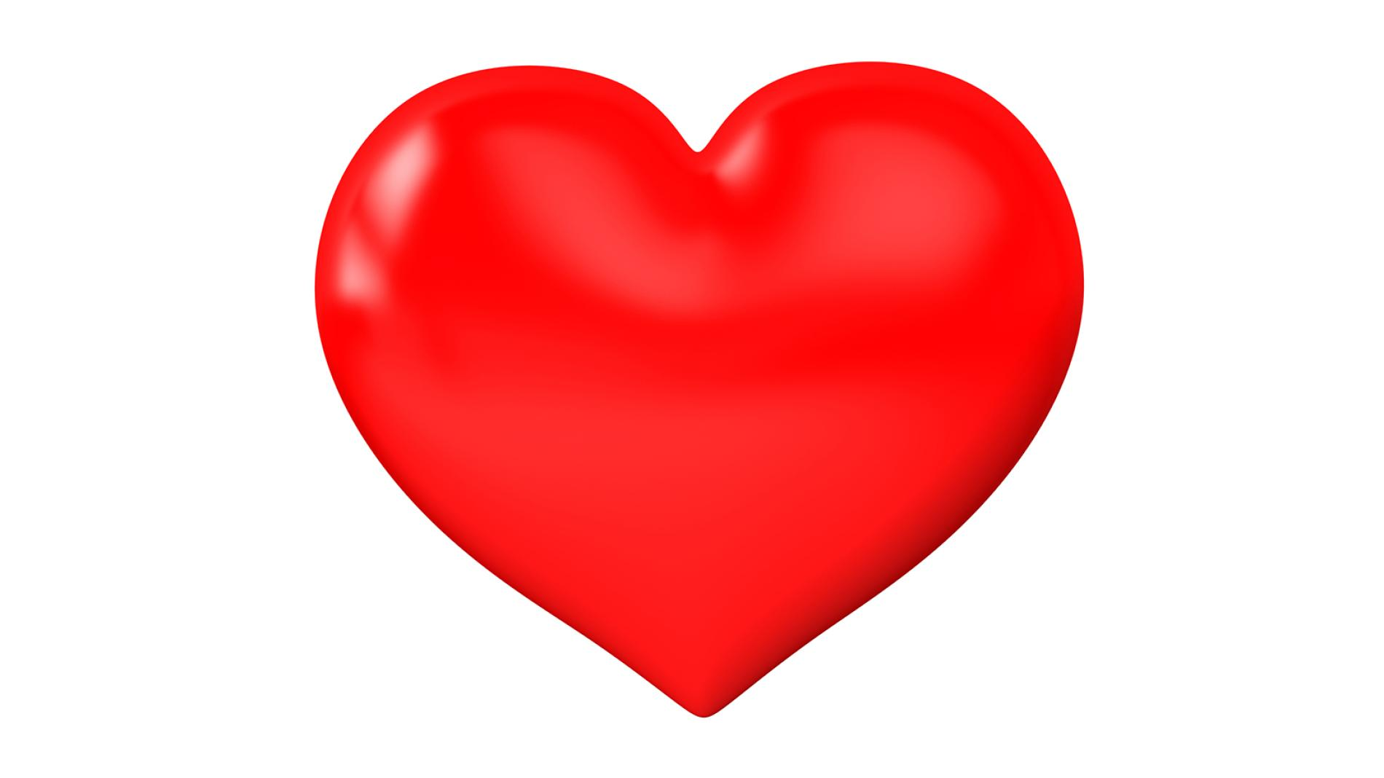
Gratitude - Role Model
About a year ago, I was going to voodoo donuts in Denver with my girlfriend and as we were walking down the sidewalk, we approached a homeless man outside of the store. I immediately noticed that he didn’t have footwear of any kind, was downtrodden, and seemed desperate. I decided to converse with him a little bit, and he started telling me a little bit about his life. He mentioned at one point he was a successful business man with a family and a beautiful house, but at one point he ended up getting extremely sick and when his health failed him, he lost everything. Despite all of this, he still had faith in the world and believed in humans’ intrinsic goodness. After a while, I realized that he probably needed my shoes more than I did. I took the shoes off, and as I handed them to him, he immediately teared up. I could tell that I had touched his heart maybe as much as he had touched mine. He is my role model when it comes to being grateful for what I have because whenever I think of him, I’m reminded that I could lose what I have in the blink of an eye.

