Slide 1
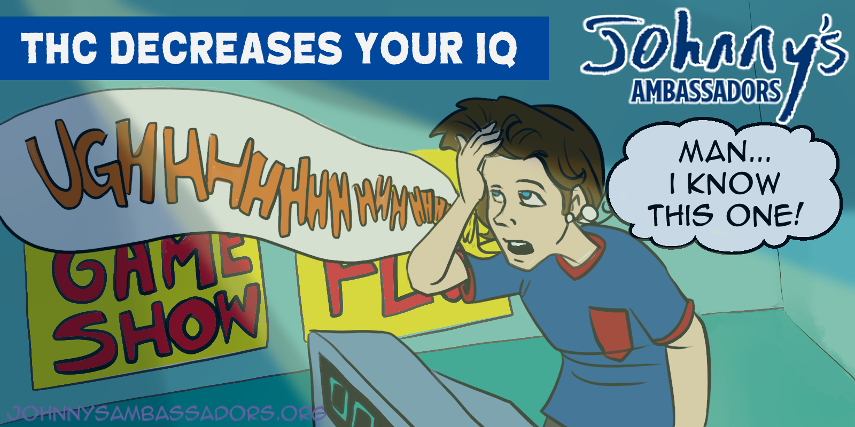
Notes:
THC changes the way the teen brain develops, particularly in the prefrontal cortex and hippocampus, where learning and memory take place. If you use a lot of THC as a teen, you can lose between SIX to EIGHT IQ points by time you are a young adult. What happens if you lose 6 to 8 IQ points? The average IQ is 100, so if you are an A student, that is a C. If you are a C student, that is an F. This can affect your ability to get into college or have a good career. Link to research: https://www.pnas.org/doi/full/10.1073/pnas.1206820109

