Slide 1
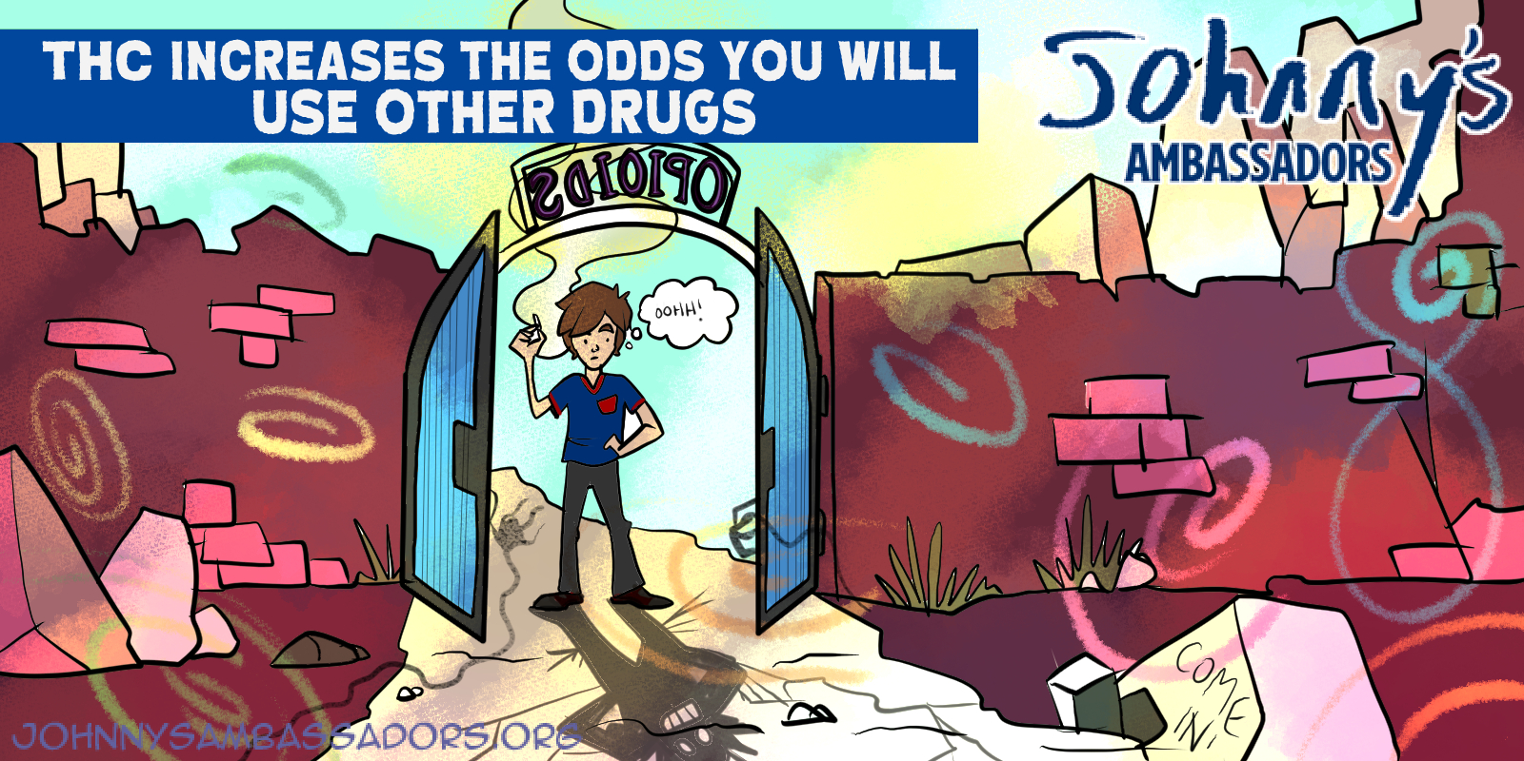
Notes:
THC Increases the Odds You Will Use Other Drugs
According to the 2019 Centers for Disease Control “Youth Risk Behavioral Study,” HAVING EVER USED marijuana was the TOP co-occurring substance use behavior for high school seniors who have abused opioids in the past 30 days, even OVER ALCOHOL use in the past 30 days. In other words, whether you have ever used THC in your lifetime was the #1 predictor a high school senior will have abused opioids in the past 30 days. Overall, adolescent marijuana users are 2.5 times more likely to abuse prescription opioids.
Link to research: https://www.cdc.gov/mmwr/volumes/69/su/su6901a5.htm#T3_down and https://www.ncbi.nlm.nih.gov/pmc/articles/PMC3552239/pdf/nihms388189.pdf

