Slide 1
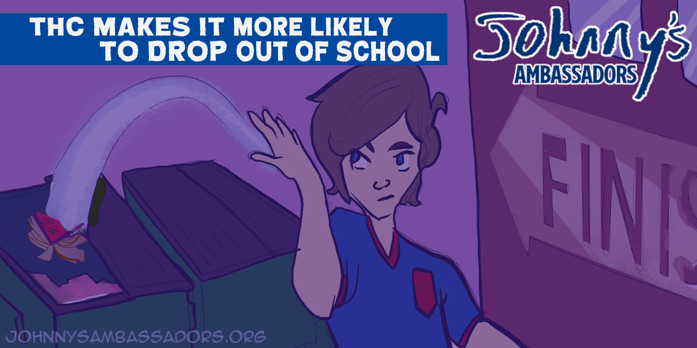
Notes:
THC Makes it More Likely To Drop Out Of School
Young people who use THC are at increased risk of poor academic performance and dropping out of school. Many studies have revealed significant associations between THC use and a range of measures of educational performance, including lower grade point average, less satisfaction with school, and negative attitudes about school. Using THC as a teen can significantly increase the risk you’ll drop out of school before you graduate.
Link to research: https://pubmed.ncbi.nlm.nih.gov/11219366

