Slide 1
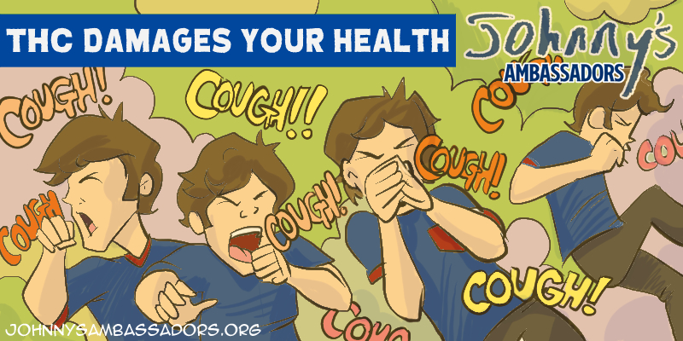
Notes:
THC Damages Your Health
Marijuana smoke can cause symptoms of chronic bronchitis, a heavy cough, and lung irritation. There is a 3.5 times greater second-hand smoke effect than from Marlboro Red cigarettes. That means if you smoke around your friends, you are damaging their lungs as well.
Marijuana smokers have worse lung damage on CT than tobacco smokers. This study reviewed chest CT examinations on 56 marijuana smokers, 57 nonsmoker controls, and 33 tobacco only smokers. Marijuana smokers had a higher rate of emphysema 75%, compared to nonsmokers 5%, and tobacco smokers 67%. Airway inflammation and emphysema were more common in marijuana smokers. Murtha. L et al. Chest CT Findings in Marijuana Smokers. Radiological Society of North America. Nov 2022.
Secondhand Cannabis Smoke is associate with more frequent respiratory symptoms among cannabis users. In a survey of 5410 adults living in Oklahoma, 42% reported past 30-day second-hand cannabis smoke exposure. Respiratory symptoms were highest among those reporting past 30 days secondhand cannabis smoke exposure and past 30-day cannabis use. Those exposed were more socially and economically vulnerable. Cohn AM, Zaring-Hinkle B, Catino JD, Ehlke SJ, Ware K, Alexander A, Smith MA, Jewell-Fleming S, Queimado L, Kendzor DE. Secondhand cannabis smoke exposure and respiratory symptoms among adults living in a state with legalized medical cannabis with limited

