Slide 1
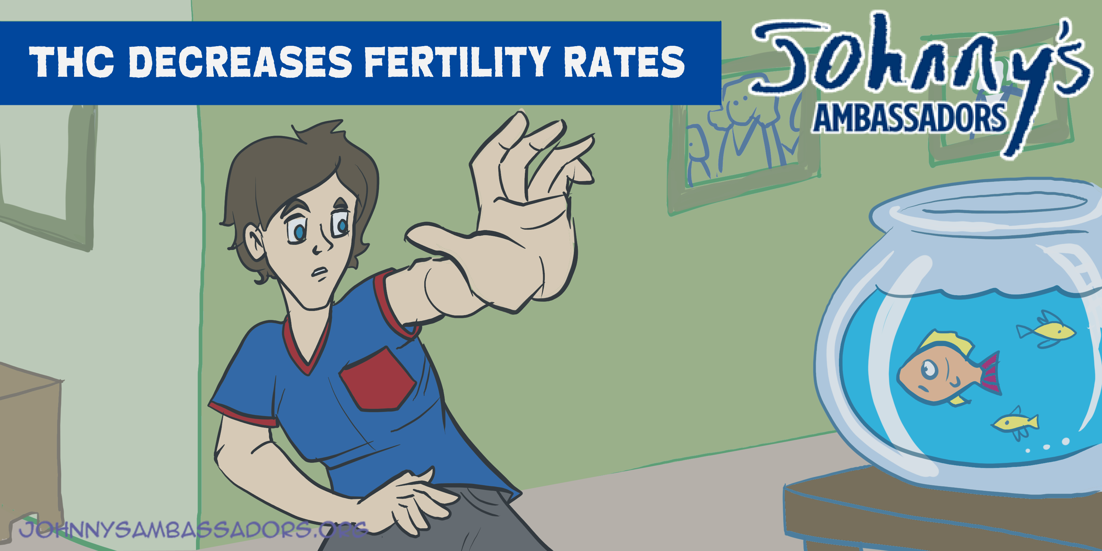
Notes:
THC Decreases Fertility Rates
If you ever want to get married and have a family, THC can affect the reproductive organs and suppress the expression of testosterone, which can delay puberty and reduce growth.
Teen THC use can negatively impact fertility in both males and females. For males, it can lead to reduced sperm count, concentration, and motility, as well as potential hormonal imbalances. In females, THC exposure, particularly during adolescence, may affect ovarian follicle development, potentially impacting egg quality and ovulation.
Cannabis and Male Fertility: A Systematic Review
The strongest evidence of cannabis induced alterations in male fertility is in the category of semen parameters. Research supports a role for cannabis in reducing sperm count and concentration, inducing abnormalities in sperm morphology, reducing sperm motility and viability, and inhibiting capacitation and fertilizing capacity.
https://pmc.ncbi.nlm.nih.gov/articles/PMC7385722/

