Slide 1
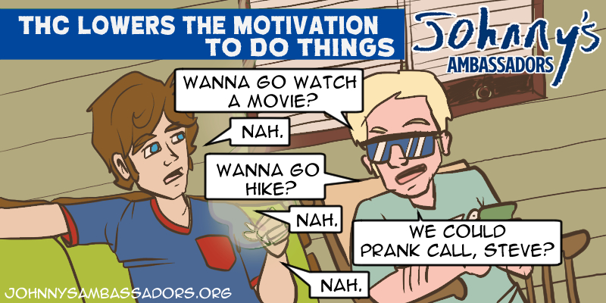
Notes:
THC Lowers Your Motivation To Do Things
THC binds to an area of the brain called the orbito-frontal cortex and reduces short-term motivation to get involved in outside activities – basically, laziness. THC can make you just want to sit on the couch or isolate yourself in your room. Teenagers who use THC, the main psychoactive component of cannabis, may experience reduced dopamine levels in the brain, which can lead to decreased motivation. Chronic cannabis use, especially during adolescence, is linked to apathy, lack of initiative, and decreased engagement in goal-directed behavior. Johnny started to drop out of extra-curricular activities one by one.
Effects of Adolescent Cannabis Use on Motivation and Depression: A Systematic Review
https://pmc.ncbi.nlm.nih.gov/articles/PMC8168938

