Slide 1
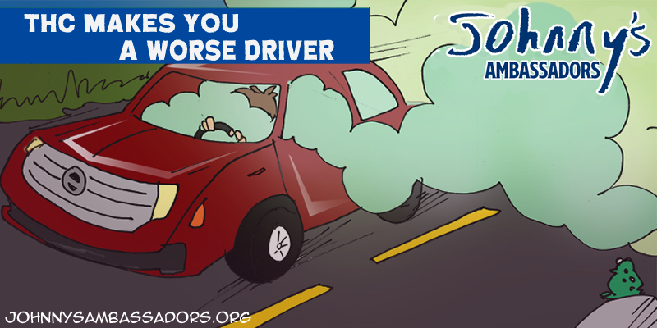
Notes:
THC Makes You A Worse Driver
THC binds with receptors in the basal ganglia and cerebellum, decreasing reaction time and coordination. Getting into a car with someone who has been using THC means you’re literally putting your life in their hands, as THC is incredibly incapacitating. It is never safe to drive impaired on any substance.
Driving is impaired for up to 4.5 hours after smoking cannabis despite a false sense of driving safety. 191 Participants were given driving simulation test after smoking placebo, 5.9% or 13.4% THC. increasing willingness to drive at 1 hour 30 minutes may indicate a false sense of driving safety. Worse driving performance is evident for several hours post smoking in many users. Marcotte TD, Umlauf A, Grelotti DJ, et al. Driving Performance and Cannabis Users’ Perception of Safety: A Randomized Clinical Trial . JAMA Psychiatry. 2022;79(3):201–209. doi:10.1001/jamapsychiatry.2021.4037

